Slide 1
Neighborhood Health Status Improvement Initiative
Barbara Zappia, MPA
Greater Rochester Health Foundation
Lauren Snyder, RN, MPA
Our Town Rocks Project, S2AY Rural Health Network
Deborah Puntenney, Ph.D.
Northwestern University, ABCD Institute

Slide 2
Content of Our Presentation
Barbara Zappia, Senior Program Officer at GRHF will discuss the Neighborhood Health Status Improvement Initiative.
DEBORAH PUNTENNEY will describe Asset-Based Community Development and its application in these grants.
Current grantee LAUREN SNYDER will talk about the Our Town Rocks project in Dundee.
QUESTIONS and ANSWERS.

Slide 3
The mission of Greater Rochester Health Foundation
is to improve the health status of all residents of the
Greater Rochester community, including people
whose unique health care needs have not been met
because of race, ethnicity or income.

Slide 4
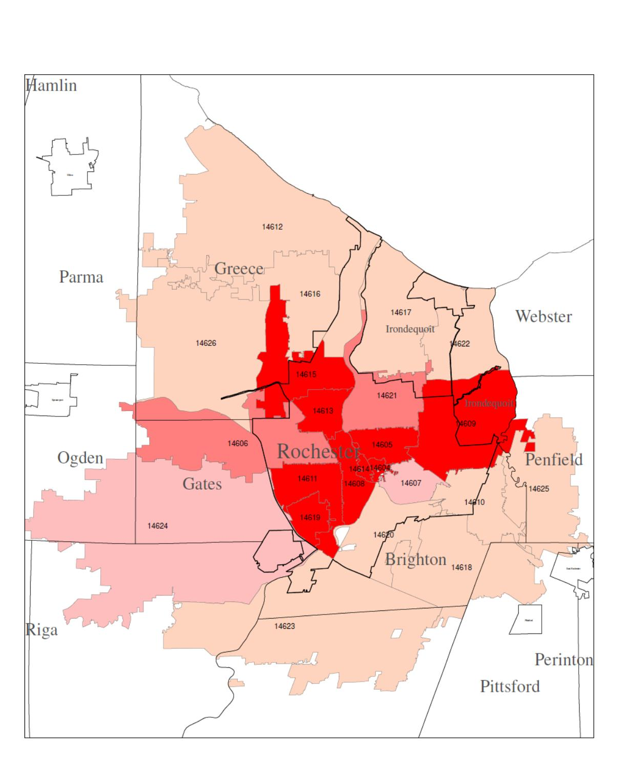
Health in the US varies by income and education as well as by racial or ethnic group and neighborhood
  Infant mortality and children’s health
  Childhood overweight and obesity
  Self-reported fair or poor health
  Activity and chronic disease
  Life expectancy

Slide 5
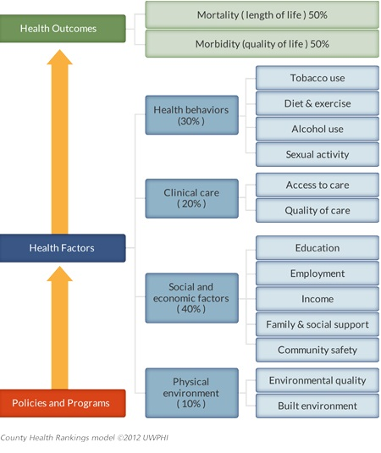
What Drives Health Outcomes?
What Drives Health Outcomes?
What Drives Health Outcomes?
MANY factors influence health outcomes.
Good health not solely the result of genetics and good medical care
In County Health Rankings model, physical, social, economic factors represent about 50% of explanatory factors that drive health outcomes.
Health care and health behaviors explain the other 50%.

Slide 6
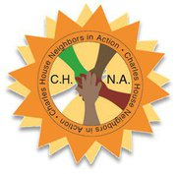



Our opportunities for better health begin where we live, work and play
Place Matters—
Attention to the physical, social, economic environments
Authentic neighborhoods
Asset-based
Partnerships
Resident- driven
Grassroots

Slide 7
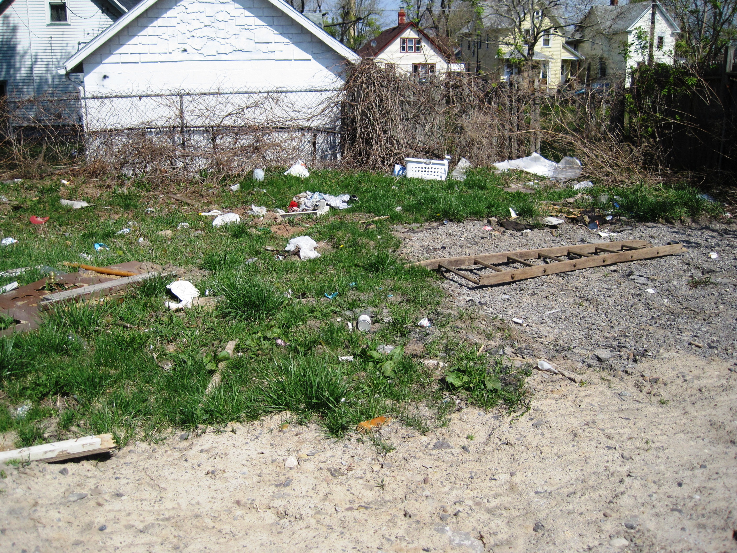
Our opportunities for better health begin where we live, work and play
Place Matters—
Attention to the physical, social, economic environments
Authentic neighborhoods
Asset-based
Partnerships
Resident- driven
Grassroots

Slide 8
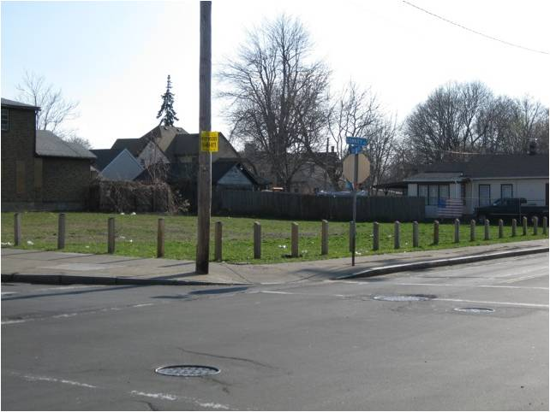
Our opportunities for better health begin where we live, work and play
Place Matters—
Attention to the physical, social, economic environments
Authentic neighborhoods
Asset-based
Partnerships
Resident- driven
Grassroots

Slide 9
Neighborhood Health Status Improvement Initiative
Assess
Plan
Do
Engagement & Assessment
  1 year, $65,000
Building Partnerships & Long-Term Planning
  1 year, $85,000
Implementation of Long-Term plan
  3 years, $185,000 per year
Future funding
  Phase IV for current grantees
  Funding for new grantees

Slide 10
Asset-Based Community Development (ABCD)
ABCD Principles:
Asset-based (built on positives, strengths, opportunities),
Relationship driven (centered on people in the neighborhood working together), and
Place based (locally focused).
ABCD Practices:
Asset mapping (finding all the good things), and
Asset mobilizing (connecting the good things for positive purposes).

Slide 11
ABCD—Perspective Matters
Empty glass: communities are full of people with needs and deficiencies
Full glass: communities are full of people with ideas, skills, and capacities
Where will you look?
What will you see?

Slide 12
ABCD—Types of Community Assets
SIX TYPES OF COMMUNITY ASSETS
Actors:
Skills and talents of LOCAL PEOPLE.
ASSOCIATIONS–the network of relationships they represent.
INSTITUTIONS, agencies, and professional entities.
Context:
PHYSICAL ASSETS and infrastructure–land, buildings.
ECONOMIC ASSETS–local economy, productive capacity.
CULTURAL ASSETS–ways of knowing, ways of being.

Slide 13
ABCD—Paradigm Change
Paradigm Change with Asset-Based Community Development:
Instead of –
Problems
Clients
Recipients
Volunteers
Consumers
At-risk populations
People who need help
Neighborhood residents are –
Problem solvers
Change makers
Contributors
Leaders
Partners
Assets to cultivate
Participants

Slide 14
Empowering Co-Producers of Health
CHANGE
ADVOCATE
The most sophisticated role a resident can undertake. An advocate connects the community’s vision and the policies that get in the way, and advocates for change.
Actor/producer is a critical role for a resident. An actor/producer is a fully engaged individual who helps define and implement community ideas as part of sustainable change.
Participant is an entry-level role. A participant is someone who gets involved, but leaves the defining the vision and developing ideas to others.
An advisor usually has little power and the role can be an empty one. Authentic advisors have decision-making power.
Some people have been victimized, but the role of victim can also be a choice; a victim will never have power.
ACTOR
PRODUCER
PARTICIPANT
ADVISOR
VICTIM

Slide 15
Asset-Based Community Development in the NHSII Grants
ABCD Application in NHSII grants
Assessment (finding assets).
Planning (engaging assets for different roles).
Doing (mobilizing assets toward plan implementation).
Three questions:
What can we do without any help?
What can we do with some help and support?
What is it really someone else’s job to do?

Slide 16
ABCD—Community Health Improvement
Activating the community:
Community residents
Grantee/project
Organizations & institutions
Policies impacting community health

Slide 17
Project Evaluation
Logic model for change

Slide 19
Our Town Rocks Project: Barrington, Starkey, and Dundee
Neighborhood Landscape: The starting place

Slide 20
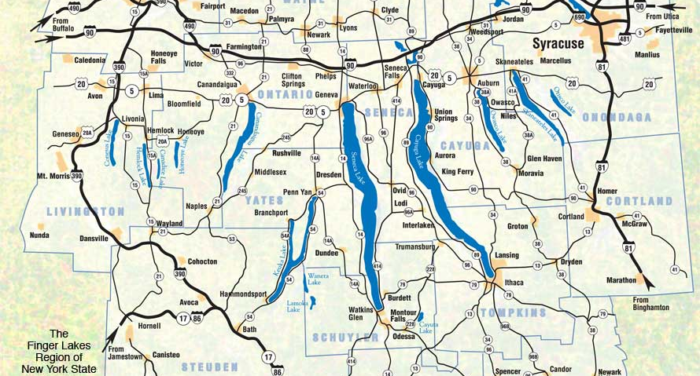
Our Town Rocks Project: Barrington, Starkey, and Dundee

Slide 21
Our Town Rocks Project: Barrington, Starkey, and Dundee
Yates County

Slide 22
Our Town Rocks Project: Barrington, Starkey, and Dundee
5,041 residents (about 15% Mennonites)
18.6% below the Federal Poverty Level (increase of 28.3% since 1990).
45% below 200% of the FPL.
79.1% of married couple families with child under age 18 lived below 130% of the FPL.
74% (PreK-6) and 37% (7-12) are on free or reduced lunch.
20% of females <24 years have a 9th grade education or less.
O% of males <24 years have a Bachelor’s degree or higher.

Slide 23
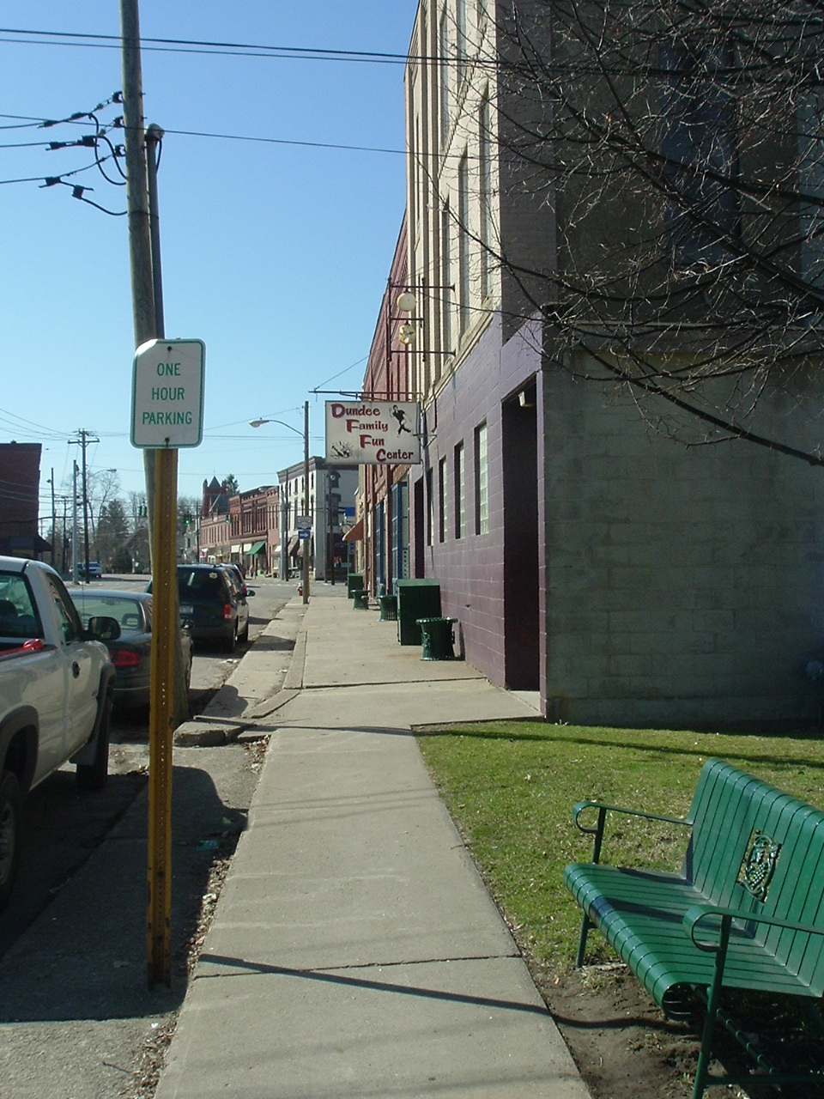
Our Town Rocks Project: Barrington, Starkey, and Dundee
Main Street, Dundee

Slide 24
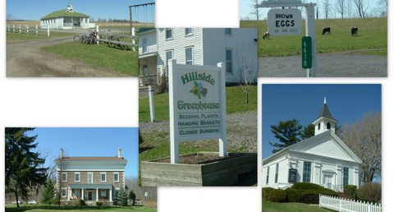
Our Town Rocks Project: Barrington, Starkey, and Dundee

Slide 25
Our Town Rocks Project: Barrington, Starkey, and Dundee
The Our Town Rocks story
From Engagement To Results

Slide 26
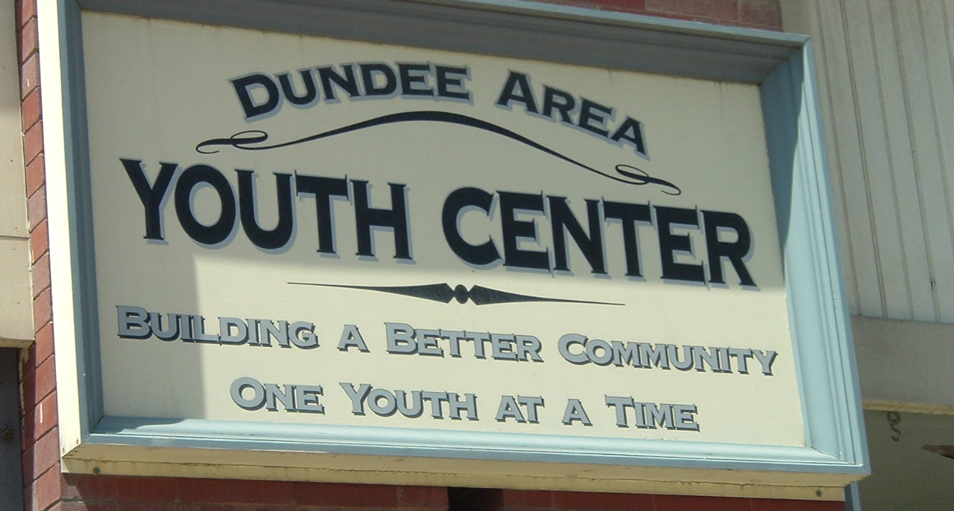
Our Town Rocks Project: Barrington, Starkey, and Dundee

Slide 27
Our Town Rocks Project: Barrington, Starkey, and Dundee
Survey of 5,041 residents who:
Care about: family, children, church, community.
Worry about: youth, drugs/alcohol, crime, jobs/taxes/poverty.
Know about: cooking, child/elder care, carpentry, sports.
Want to change: more business/restaurants, activities, improve streets/sidewalks, clean-up/increase appeal.
Want to help: 86% of respondents.

Slide 28
Our Town Rocks Project: Barrington, Starkey, and Dundee
Key priorities from survey:
Changing Personal Health Behaviors: related to tobacco, drug and alcohol use, physical activity, nutrition, stress management, violence prevention.
                Increasing Access To Services: such as GED classes, transportation, WIC, family planning.
                Increasing Activities: for youth, seniors, families, intergenerational.
Increasing Economic Opportunities: more small business, jobs, stores, restaurants, housing.
Beautifying the Project Area: Improve Main Street, parks, general clean-up.

Slide 29
Our Town Rocks Project: Barrington, Starkey, and Dundee
Key priorities from survey:
Changing Personal Health Behaviors: related to tobacco, drug and alcohol use, physical activity, nutrition, stress management, violence prevention.
                Increasing Access To Services: such as GED classes, transportation, WIC, family planning.
                Increasing Activities: for youth, seniors, families, intergenerational.
Increasing Economic Opportunities: more small business, jobs, stores, restaurants, housing.
Beautifying the Project Area: Improve Main Street, parks, general clean-up.

Slide 30
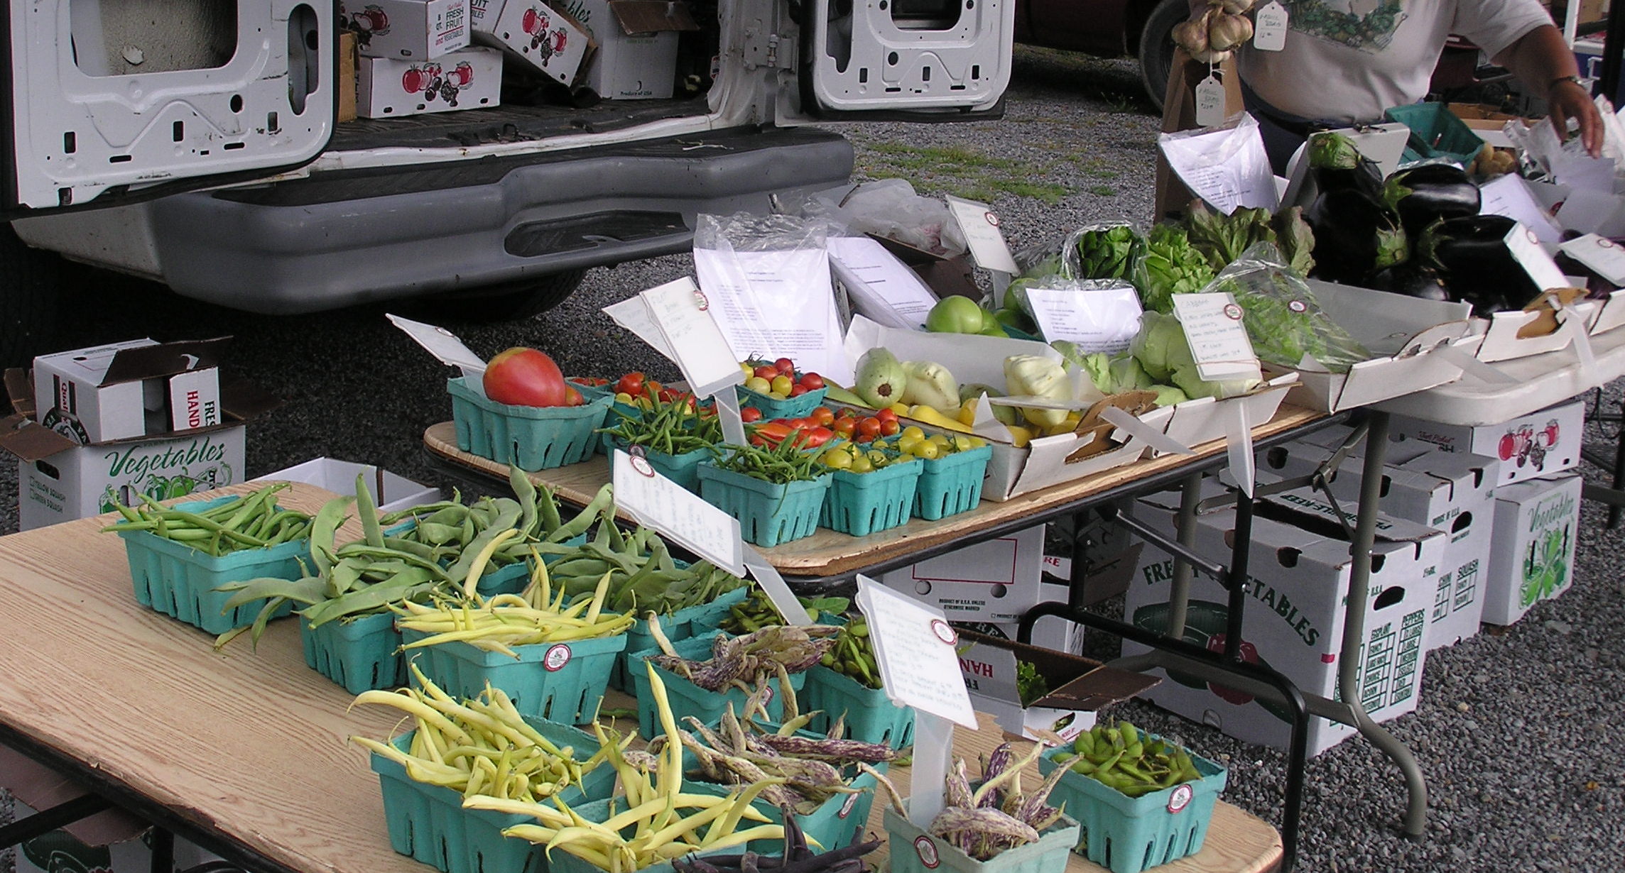
Healthy Eating

Slide 31
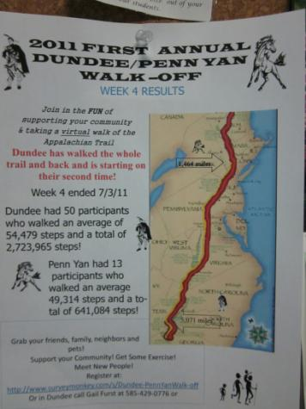
Physical Activity

Slide 32
Our Town Rocks Project: Barrington, Starkey, and Dundee
Neighborhood landscape now, what has changed
next steps for the community

Slide 33
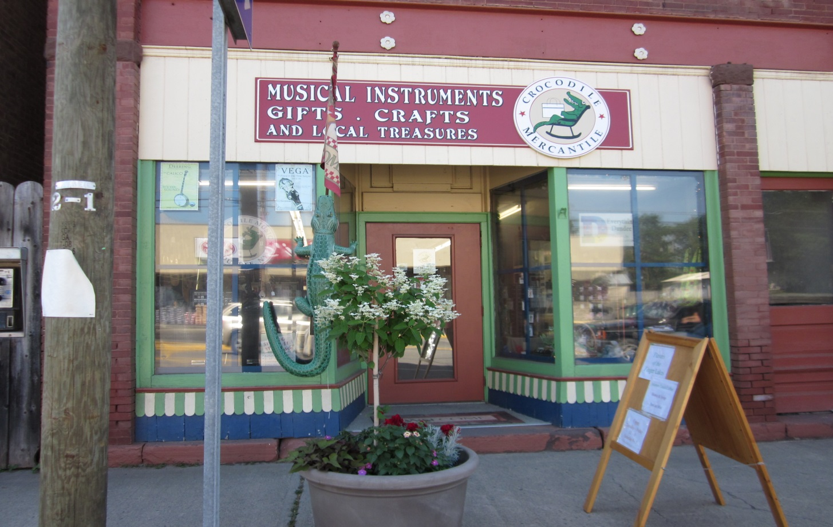
Our Town Rocks Project: Barrington, Starkey, and Dundee
What has changed? Some changes are visible–

Slide 34
Our Town Rocks Project: Barrington, Starkey, and Dundee
Some changes are not visible:
Revitalization committee has merged with OTR Community meeting.
Residents have learned that they can accomplish things they thought were impossible.
Municipalities and organizations have learned that they can come to the residents of the community for input and assistance.
Residents have learned that they can go to their local government and local agencies and expect respectful cooperation.
Residents have discovered a sense of hopefulness can lead to achievement.

Slide 35
What’s Next for 2013-2016?
Continue all the activities that have worked
Activities with a life of their own – support them!
New activities examples:
  Expand reading program, Book club, book fest
  Hold a Rock-a thon
  Provide “After Hours” for adults, “After Hours for kids” focus on culinary arts, STEM, etc. Job fair for students.
  More microenterprise start up or expansion
  Promote the area
  Explore development of middle income retirement housing

Slide 36
How do we measure results?
Outputs:
  Reported every quarter, activities that affect the social, physical, economic aspects of community
Resident surveys:
  Short-term (1-2 year) outcomes – changes in beliefs
  Medium-term (3-6 year) outcomes – changes in behaviors, medical conditions (BP, cholesterol, blood sugar, stress)
  Long-term (10-15 year) outcomes – changes in health status ( cardio-vascular disease, diabetes, depression/anxiety, stroke)

Slide 37
Age-Adjusted Fruits and Vegetables
Eaten Yesterday

Slide 38
High Cholesterol

Slide 39
Angina / Coronary Heart Disease

Slide 40
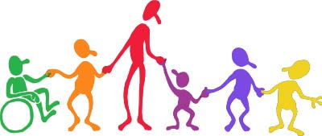
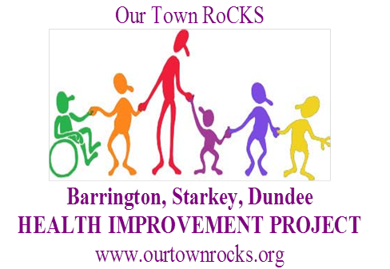
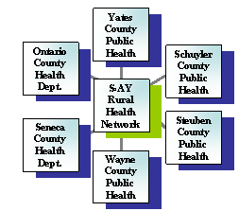

Our residents will be healthy and prosperous, will avoid chronic disease, and will enjoy long and fulfilling lives.
Our Town Will RoCK!

Slide 41
Neighborhood Health Status Improvement Initiative
Questions?

